Slide 1

Tools & Strategies for Consuming APIs

Slide 2



































TITANIUM SPONSORS
Platinum Sponsors
Gold Sponsors

Slide 3
What this talk…
…is
…Isn’t
3rd Party Web APIs
Types of APIs
Tools for testing
Coding strategies
Communicating with owner
Building APIs
Evaluating APIs
Judgy
Oh… and beer

Slide 4
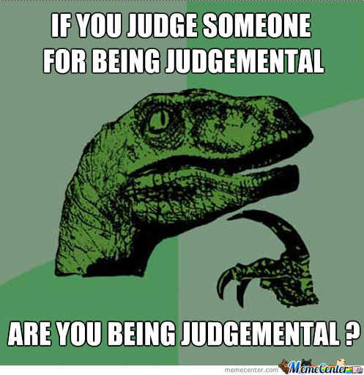

Slide 5
Application Programming Interface
“…a set of subroutine definitions, protocols, and tools for building application software. In general terms, it is a set of clearly defined methods of communication between various software components.”
- wikipedia

Slide 6
API types
RPC (remote procedure call)
REST (representational state transfer)
SOAP (simple object access protocol)

Slide 7



Slide 8
If we want beer…
 | RPC | REST
Get all beers | GET /GetAllBeers | GET /beers
Get a single beer | GET /GetBeer?beerid=001 | GET /beers/001
Add a beer | POST /AddBeer | POST /beers
Update a beer | POST /UpdateBeer?beerid=001 | PUT /beers/001
Delete a beer | POST /DeleteBeer?beerid=001 | DELETE /beers/001

Slide 9
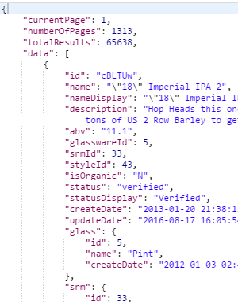
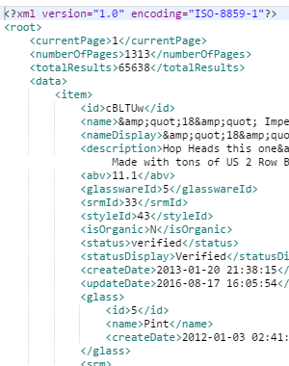
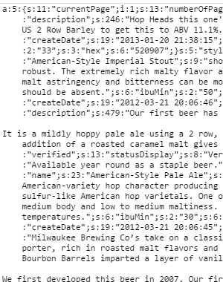
Response types
JSON XML PHP

Slide 10
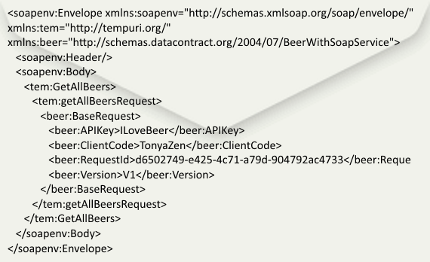
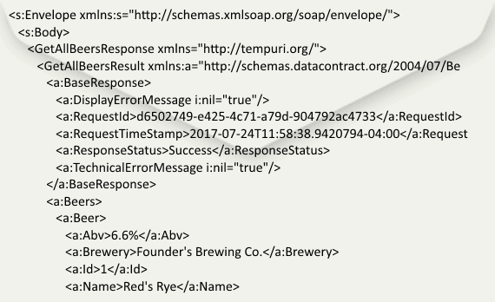
If we want beer with SOAP…

Slide 11


Slide 12


Tools
Airborne
Apex Ping
Apigee Api Studio
Assertible
Chakram
DreddHippie
HttpMaster Express
Karate DSL
Mockbin
Postman
Pyresttest
Rest-Assured
Rest Console
RestSharp
RoboHydra Server
SoapUI
Swagger
WebInject

Slide 13
Demo!

Slide 14
Code Review
Separate your service layer
Consider implementing an interface for your service class
Set up your logging right away
Wrap your API calls in Try/Catches
Consider using a response object that includes a call status and message
Create your own objects

Slide 15
Cheers to Good Communication
First… consult the documentation
Utilize their ticketing system
Provide raw request and response
Be nice

Slide 16
Drink Responsibly! Questions?

